Slide 1
Revision Note
Memory Management
Virtual Memory
Mass Storage Structure
File Systems Implementation

Slide 2
Logical addresses space concept
Each program has its own address space like before.
Upon loading the program codes onto the memory, the system convert the addresses generated by a program into another set of addresses (Physical addresses).
The codes will be loaded into these physical addresses of the memory
The conversion make sure the addresses from multiple different programs are converted into distinct set of physical addresses.
Logical Address Spaces
The addresses generated by a program, it is use in the process and CPU
Address Spaces
A set of addresses use by a program is called address space.

Slide 3
Converting Logical to Physical Address
Logical address space has to be mapped to physical memory guided by base and limit value..
Each process is assigned a base and limit value. base is the location in physical address where the process can start loading its codes, limit is the length of memory spaces available to this particular process.
All processes, except the OS kernel, can only access to the memory spaces in between base and limit. Exceeded which will be an illegal process.
base and limit value will be stored in CPU registers when the process is running
RAM
limit
Program
base
0
Logical address is also called a virtual address.

Slide 4
Base and Limit Registers

Slide 5
Memory-Management Unit (MMU)
Hardware device that maps logical (virtual) to physical address
In MMU scheme, the value in the relocation register (base register) is added to every address generated by a user process at the time it is sent to memory
The user process deals with logical addresses

Slide 6
Swapping
A process can be swapped temporarily out of memory to a backing store, and then brought back into memory for continued execution.
Backing store – fast disk large enough to accommodate copies of all memory images for all users.
Roll out, roll in – swapping variant used for priority-based scheduling algorithms; lower-priority process is swapped out so higher-priority process can be loaded and executed.
Major part of swap time is transfer time; total transfer time is directly proportional to the amount of memory swapped.

Slide 7
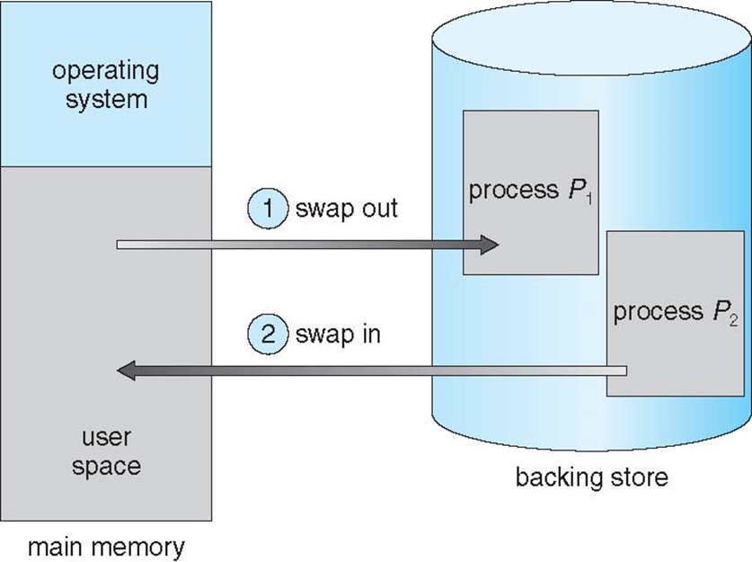
Swapping

Slide 8
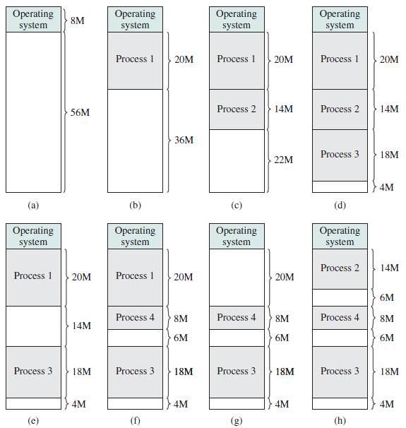
Problems：Fragmentation
Holes scattered throughout memory
External Fragmentation – total memory space exists to satisfy a request, but it is not contiguous
Internal Fragmentation – allocated memory may be slightly larger than requested memory, the leftover unused memory caused internal fragmentation

Slide 9
Reduce External Fragmentation
Compaction – shuffle memory contents to place all free memory together in one large block
Consideration: -
Possible only if memory relocation is dynamic, and is done at execution time.
The process is latched in the memory while it is in the middle I/O. One possible solution is by allocating OS buffers for I/O processes.

Slide 10
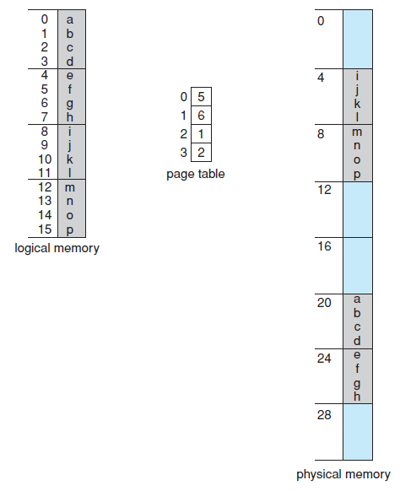
Paging Example
16 bytes memory, how many bits required to address it?
4-bit logical address
0
1
1
1
Page number
Offset/displacement
Lookup from page table
Frame number
0
1
1
1
0
1
1

Slide 11
Address Translation Scheme
Logical address is divided into: -
Page number (p) – used as an index into page table which contains base address of the corresponding frame
Page offset (d) – combined with base address of the translated frame to produce the physical memory corresponding to the logical address
Page number
Page offset
p
d
m - n bits
n bits
For a given logical address space 2^{m} and page size 2^{n}

Slide 12
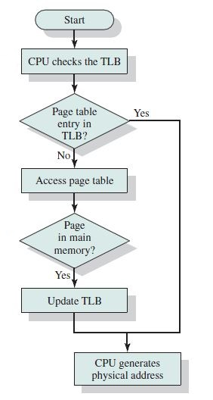
Translation Look-Aside Buffer (TLB)

Slide 13
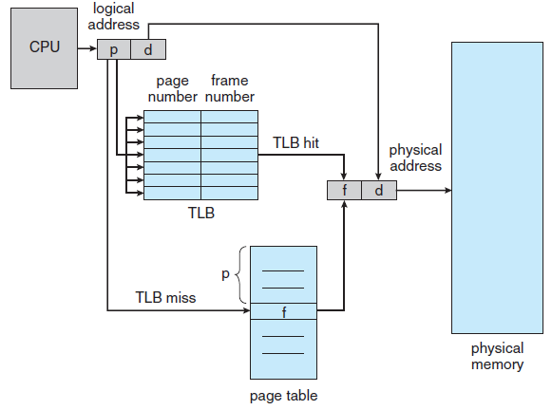
Translation Look-Aside Buffer (TLB)

Slide 14

Structure of the Page Table
Single dimension page table
Suitable for small address space
Simple
What if I have 10 big processes
50 processes for my server?
4 GB of logical memory
Each page of 4 kb memory
=
Around 1 million entries of page table
Each entry occupy 4 bytes
=
Around 4 Mb memory to store page table

Slide 15
Structure for the Page Table
Hierarchical Page Tables
Break up the logical address space into multiple page tables
A simple technique is a two-level page table

Slide 16
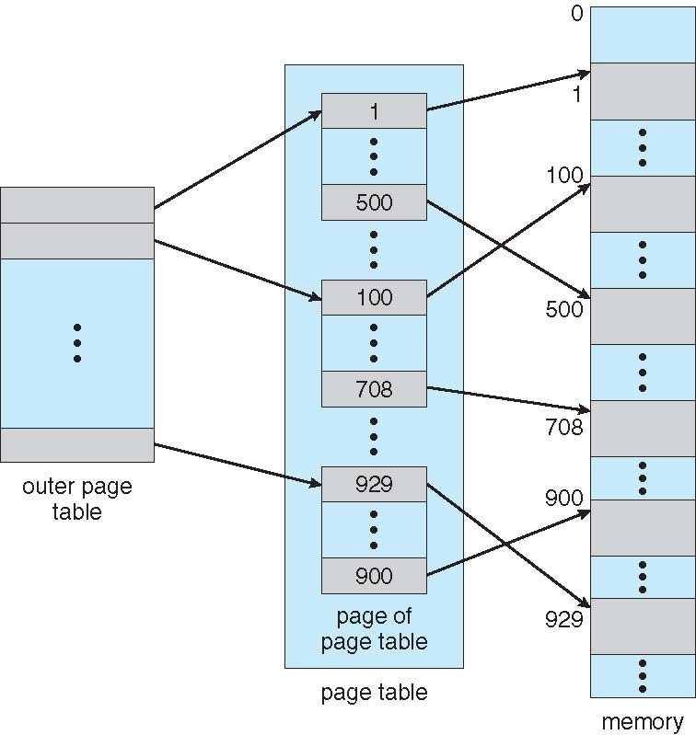
Structure of the Page Table
Hierarchical Paging

Slide 17
Hierarchical Paging – Two-Level Paging
A logical address (on 32-bit machine with 1K page size) is divided into:-
A page number consisting of 22 bits
A offset consisting of 10 bits
The 22-bit page number is further divided into: -
12-bit first-level page number, p1
10-bit second-level page number, p2
First-level
page number
Second-level
page number
Offset
p1
p2
d
12-bit
10-bit
10-bit

Slide 18
Address-Translation Scheme
Page number
Page offset
p1
p2
d
p1
.
.
d
p2
Outer page table
Physical memory
Second-Level page table

Slide 19
Example: Table size – Two-Level page table
8MB
What is the size for the two-level page table if the entry size is 4 bytes?
Process A
Logical address length = 32 bits
Pagesize = 4096 bytes
Unused
Page number
Page offset
p1
p2
d
2³² bytes
10-bit
10-bit
12-bit
12MB
TIP: Page table entry is created only for used memory addresses
Process A

Slide 20
Example: Table size – Two-Level page table
Each entry is a pointer to a frame that can hold 4KB content.
Hence, a second-level page table can address: -
2¹⁰ x 4KB = 4MB
To address spaces for 8MB + 12MB memory space: -
20MB / 4MB = 5 second-level page table.
Total page table: -
1 outer page table + 5 second-level page table.
Hence, 6 tables with 1024 entries each occupy 4 bytes: -
6 x 1024 x 4 bytes = 24KB
Page number
Page offset
10-bit
10-bit
12-bit
2¹⁰
entries
………
2¹⁰
entries
………

Slide 21
Structure for the Page Table
Hashed Page Tables
Common is address spaces larger than 32 bits
Use a fixed size page table (hash table)
The virtual page number (“page” part of the virtual address) is hashed into a page table (hash page)
This page table contains a chain of elements hashing to the same location
Virtual page numbers are compared in this chain searching for a match
If a match is found, the corresponding physical frame is extracted

Slide 22
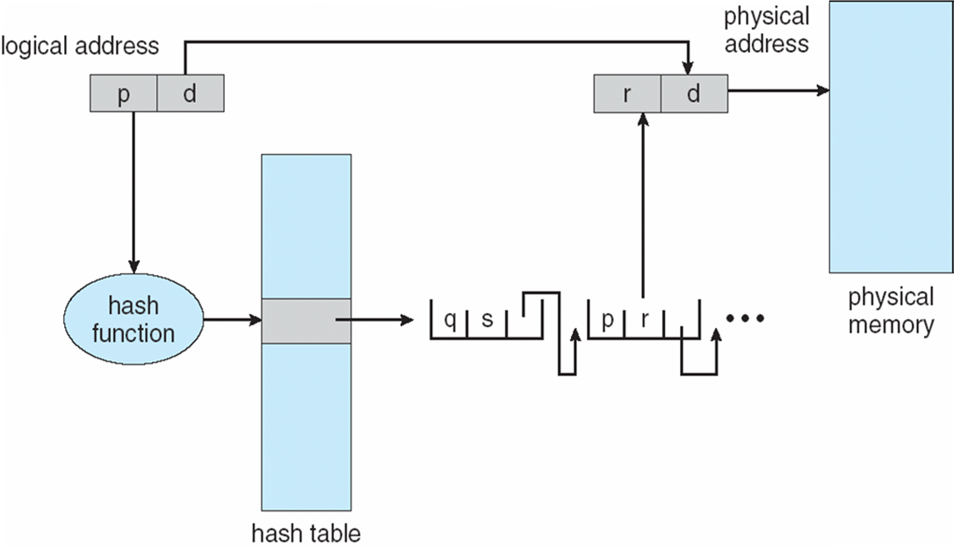
Hashed Page Table
Hashed Page Tables：the virtual page number is hashed into a page table

Slide 23
Exercise
Given Process A with logical address length of 32 bits is partially loaded into the memory as shown in the diagram below. If the page size is 1024 bytes and each page table entry occupy 4 bytes space, how much memory is required to store the two-level page table for the process?
7011 bytes
2³² bytes
Unused
3616 bytes
Process A

Slide 24
Background
Virtual Memory – Allow the separation of logical memory from physical memory
Benefits: -
Only part of the program needs to be loaded in memory for execution. Hence,
Can allow more processes to run concurrently
Process can startup in shorter time
Logical address space can be much larger than physical memory
Allow large program to executes
Shared process can be shared more efficiently

Slide 25
Virtual Memory
Only part of the program needs to be in memory for execution
Only keep referenced pages in main memory
Keep unreferenced pages on slower, cheaper backing store (disk)
Bring pages from disk to memory when necessary

Slide 26
Page Fault
While CPU is referencing an instruction, it will first consulting the page table, if the valid-invalid bit for that page entry is i, it will cause page fault.
Page fault is handled following these steps: -
CPU reference a page which has i in its valid/invalid bit.
A page fault trap will be sent to the OS
OS looks at another table to decide: -
Invalid reference => abort
Valid reference but content not in memory. Find the page in the disk.
Get empty frame. Swap the page into the available frame (May need to remove a page, if the removed page has been modified since brought from the disk, then we need disk I/O to swap it out)
Update page table
Restart the instruction that caused the page fault

Slide 27
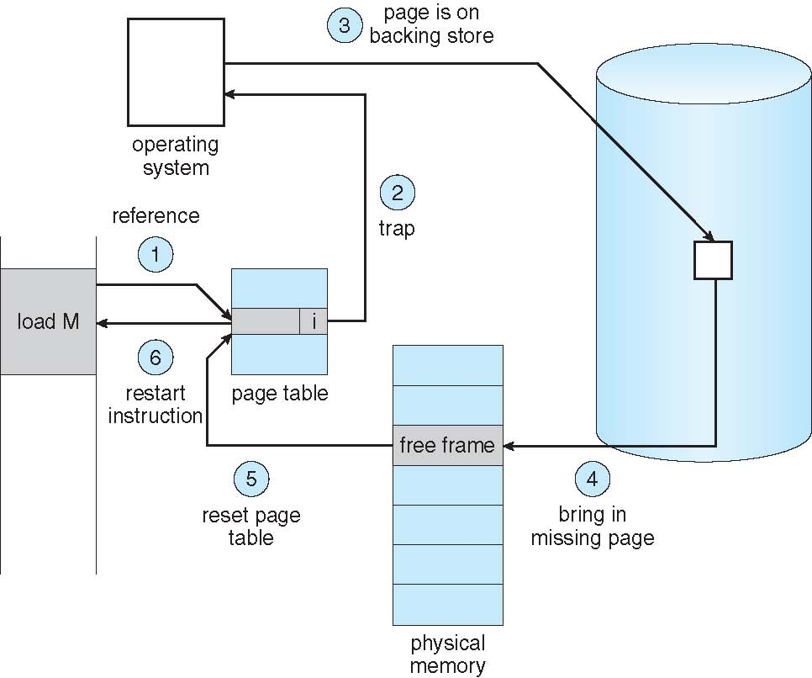
Page Fault

Slide 28
Derive a Reference String
If pages are being referenced in the following order:
7, 0, 1, 1, 1, 2, 2, 0, 3, 3, 3, 3, 0, 0, 4, 2, 3, 0, 0, 3, 0, 3, 3, 2, 1, 1, 1, 1, 2, 2, 0, 1, 1, 7, 7, 0, 1, 1, 1
Same page being referred consecutively will not cause page fault.
Therefore, reference string is:
7 ,0 ,1 ,2 ,0 ,3 ,0 ,4 ,2 ,3 ,0 ,3 ,0 ,3 ,2 ,1 ,2 ,0 ,1 ,7 ,0 ,1

Slide 29
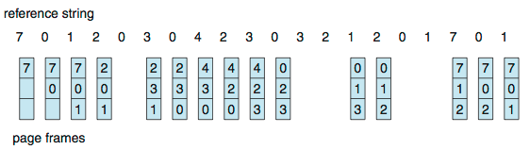
First-In-First-Out (FIFO) Algorithm
Reference string: 7,0,1,2,0,3,0,4,2,3,0,3,0,3,2,1,2,0,1,7,0,1
3 frames, 15 faults

Slide 30
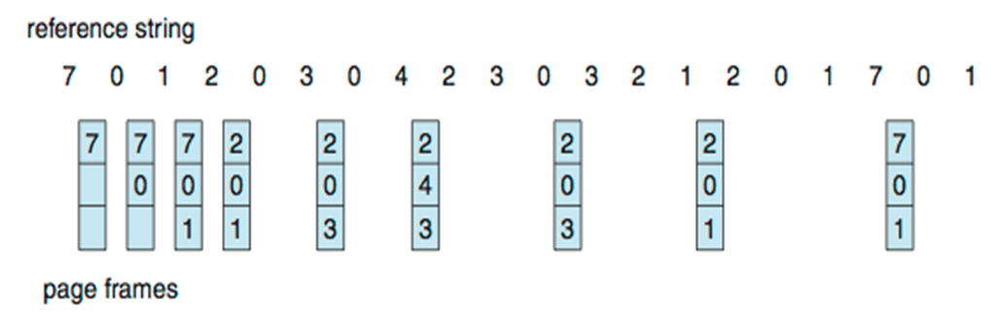
Optimal Page Replacement
Replace page that will not be used for longest period of time

Slide 31
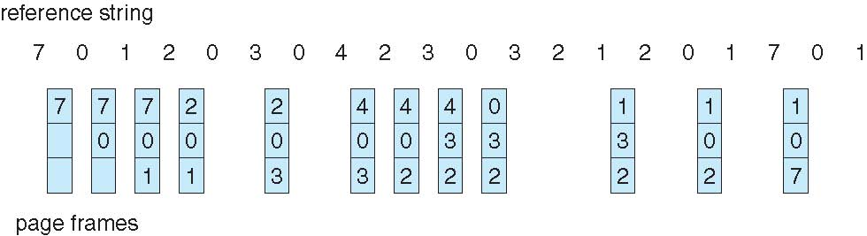

Least Recently Used (LRU) Algorithm
Use past knowledge rather than future
Replace page that has not been used for the longest time
12 faults – better than FIFO but worse than OPT
Generally good algorithm and frequently used

Slide 32
LRU Approximation Algorithms
Reference bit
With each page associate a bit, initially = 0
When page is referenced bit set to 1
Reference bits are reset to 0 periodically (with every clock interrupt)
Select the page with reference bit = 0 (if one exists) for page replacement

Slide 33
LRU Approximation Algorithms
Clock Interrupt
Clock Interrupt
Timeline
1
0
1
0
1
0
0
0
0
0
0
0
0
0
1
0
1
0
1
0
1
0
0
0
0
0
1
0
1
0
1
0
Not being used since last clock interrupt

Slide 34
Second Change Algorithms
Second-chance algorithm
Combination of FIFO and LRU Approximation Algorithms
FIFO that is checking reference bit
If page to be replaced, look to the FIFO queue; remove the page close to the Head of the queue and that has reference bit 0.
If the page encountered has reference bit 1, move it to the Tail of the queue and set the reference bit to 0. Go to the next page on the queue until you find the one with reference bit 0.
1
1
0
0
1
Head (Oldest)
Tail

Slide 35
Second Chance Clock Algorithms
Second Change Algorithms implemented using circular queue

Slide 36
RAID
Redundant Array of Independent Disk
Multiple disk drives provide reliability and performance via redundancy
Probability of more than 1 disk fail at the same time is low
6 levels of RAID

Slide 37
Multiple Disks
Block 0
Block 1
Block 0
Block 1
Block 2
Block N
Block 2
Block N
What have I achieved?

Slide 38
RAID
Multiple disks working cooperatively
Disk striping uses multiple disks as one storage unit
Improvement
RAID schemes store redundant data to improve data reliability
Mirroring or shadowing keeps duplicate of each disk
Hamming and parity

Slide 39
RAID Controller
Operating System
Give me blocks (N,…N+k)
RAID Controller
Give me block N
Give me block N+3
Give me block N+1
Give me block N+2
Disk Controller
Disk Controller
Disk Controller
Disk Controller
Block N
Block N+1
Block N+2
Block N+3

Slide 40
Disk Scheduling
Several algorithms exist to schedule the servicing of disk I/O requests.
Assume that: -
a disk has cylinders from 0 to 199
Request queue has requests for blocks on the following cylinders: -
98, 183, 37, 122, 14, 124, 65, 67
Head pointer 53

Slide 41
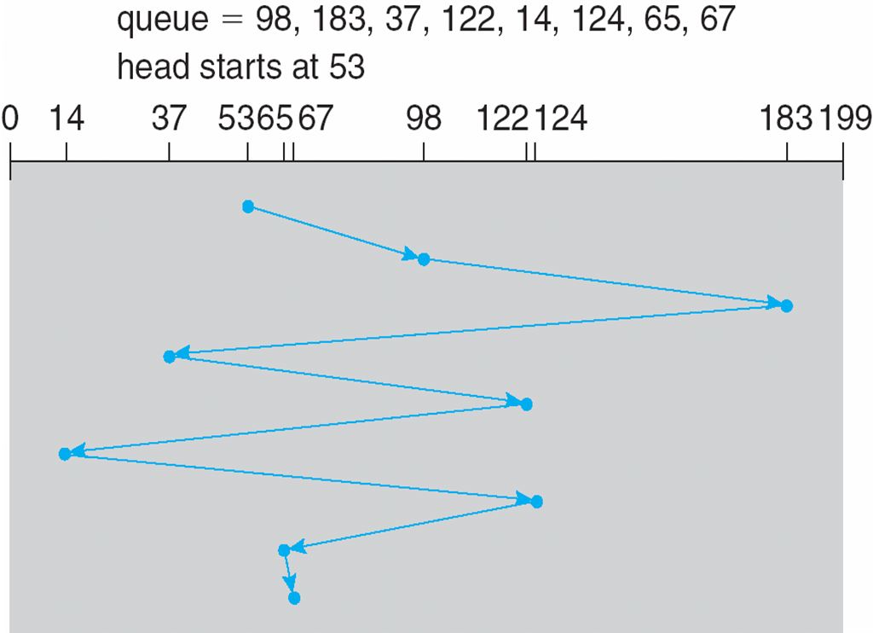
FCFS
Illustration shows total head movement of 640 cylinders (Seek distance)

Slide 42
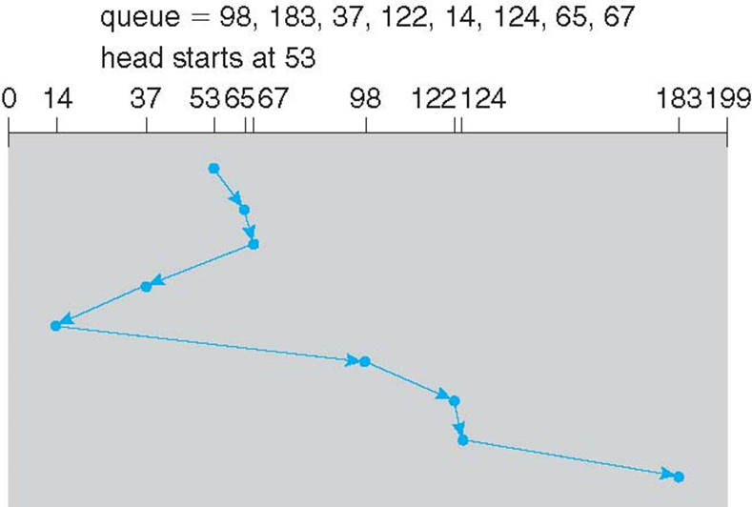
SSTF
Shortest Seek Time First selects the request with the minimum seek time from the current head position
May cause starvation
Illustration shows total head movement of 236 cylinders

Slide 43
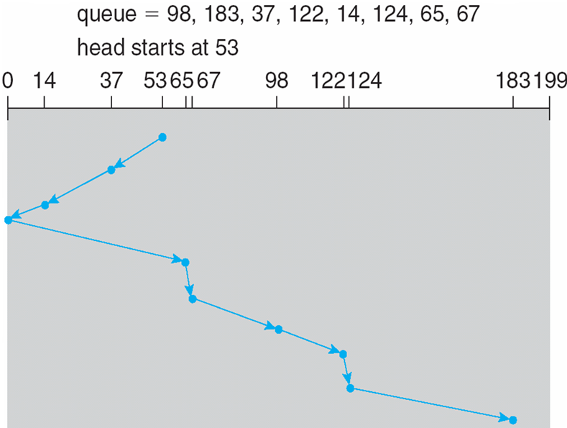
SCAN
The disk arm starts at one end of the disk, and moves toward the other end, servicing requests until it gets to the other end of the disk, where the head movement is reversed and servicing continues.
Illustration shows total head movement of 236 cylinders

Slide 44
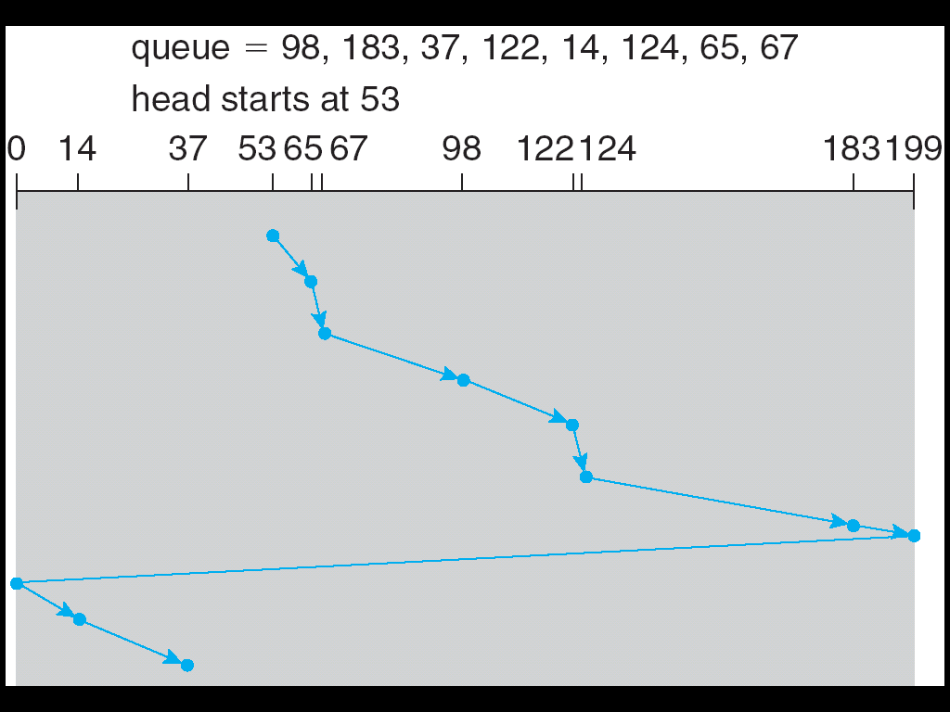
C-SCAN
Circular SCAN provides a more uniform wait time than SCAN
The head moves from one end of the disk to the other, servicing requests as it goes
When it reaches the other end, however, it immediately returns to the beginning of the disk, without servicing any requests on the return trip

Slide 45
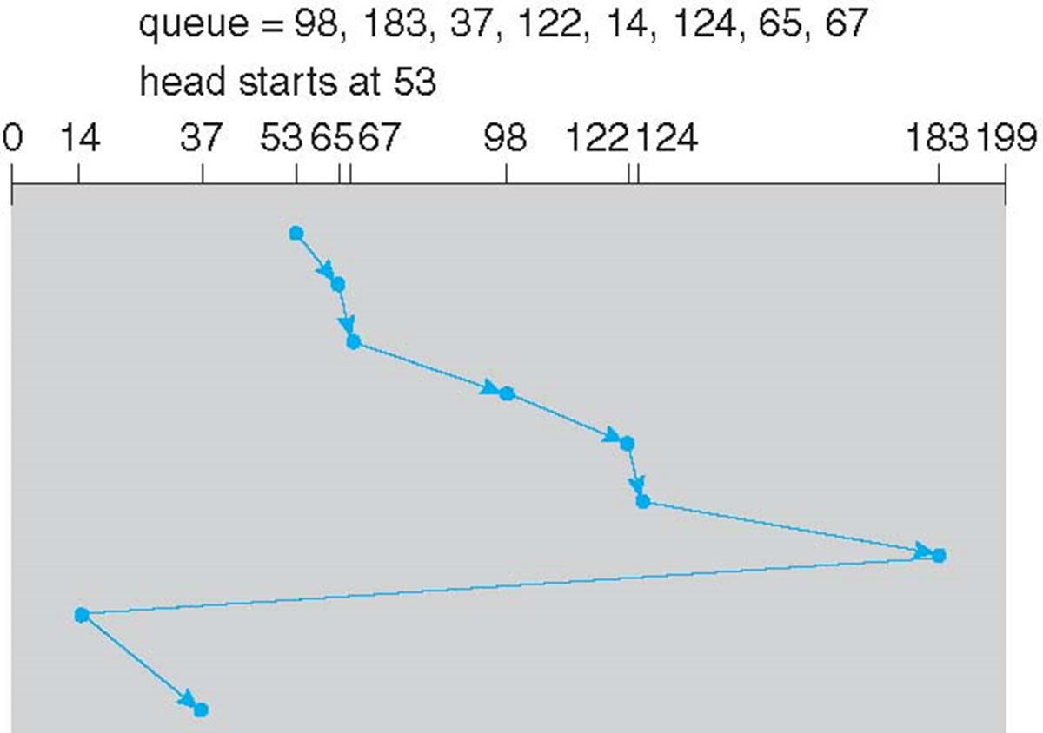
C-LOOK
C-LOOK a version of C-SCAN
Arm only goes as far as the last request in each direction, then reverses direction immediately, without first going all the way to the end of the disk

Slide 46
Linked Allocation
Each file is a linked list of disk blocks
Linked blocks can be scattered anywhere on the disk
No external fragmentation
FCB keep the pointer to the first block
Every block has a pointer to the next block to link the list
Block Size (Usually power of 2) = Pointer Size + Data Size
Block Structure
Pointer
Data

Slide 47
Linked Allocation - Example
File
Starting Block 4 (As recorded in FCB)
Required blocks = 4
0
1
2
3
4
5
6
7
8
9
2
7
1
Disk blocks (Physical blocks)

Slide 48
What are the limitation for Linked Allocation?
Inefficient on random access – multiple disk access
Occupied additional space for pointers

Slide 49
Linked Allocation – Address Mapping
Mapping from Logical Address to Physical Address
Q
Logical Address / (Block Size – Pointer Size)
R
Disk Block To Be Accessed = Q_{th} (Q+1)disk block of the linked blocks
Displacement Into Disk Block = R + Pointer Size

Slide 50
Linked Allocation - Example
Assume that:
Block size = 1024 bytes
Pointer size = 4 bytes
File size = 4000 bytes
Start block = Block 4
Question
What is the block number and displacement into the block given an instruction to access Logical Address 2900?
2900 / (1024 – 4) = 2
2900 % (1024 – 4) = 860
Follow the link 2 times starting from block 4
Offset into the block by 860 + 4 (Pointer)
0
1
2
3
4
5
6
7
8
9
2
7
1
1
2
0
3
Disk blocks (Physical blocks)

Slide 51
Indexed Allocation
Bring all pointers together into an index block
Each file has its own index block, which is an array of disk-block addresses
The ith entry in the index block points to the ith block of the file
When the file is created, all pointers in the index block are set to null.
When the ith block is first written, a block is obtained from the free-space manager, and its address is put in the ith index-block entry.

Slide 52
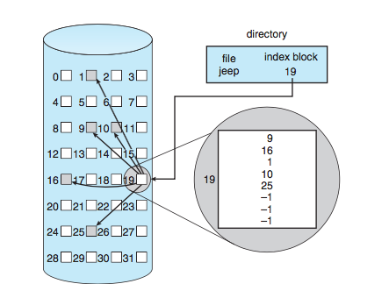
Indexed Allocation
The directory contains the address of the index block
Index table entries are ordered by the blocks of the file
Supports efficient direct access
No external fragmentation, but overhead on index block

Slide 53
Indexed Allocation – Mapping Address
For small file with max 256Kb, we need only 1 block of index block assuming: -
a block is 512 words
A pointer is 1 word long
For mapping logical to physical address for file with only 1 index block: -
Q
Entry number of the index table
Logical Address / Block Size
R
Displacement into block

Slide 54
What should we do if a file is large?

Slide 55
Indexed Allocation – Linked Scheme
0
0
0
511
511
511
A link of index blocks

Slide 56
Linked Scheme – Mapping Address
Q₁
Block number for index table
Logical Address / (Block Size x Number of Index Entries)
R₁
Used to calculate displacement
Q₂
Displacement into index block
R₁ / Block Size
R₂
Displacement into data block

Slide 57
Linked Scheme – Mapping Address Example
In a system implementing linked scheme, assuming that the block size is 512 words and each entry of the index table occupy 1 word. Calculate the following given a logical file pointer pointing at location 635109: -
block number of the index table
displacement into the block of index table
displacement into the block of file
Block number = 635109 / (512 x 511) = 635109 / 261632 = 2
R1 = 635109 % (512 x 511) = 635109 % 261632 = 111845
Displacement into index table = 111845 / 512 = 218
Displacement into data block = 111845 % 512 = 229

